Slide 1

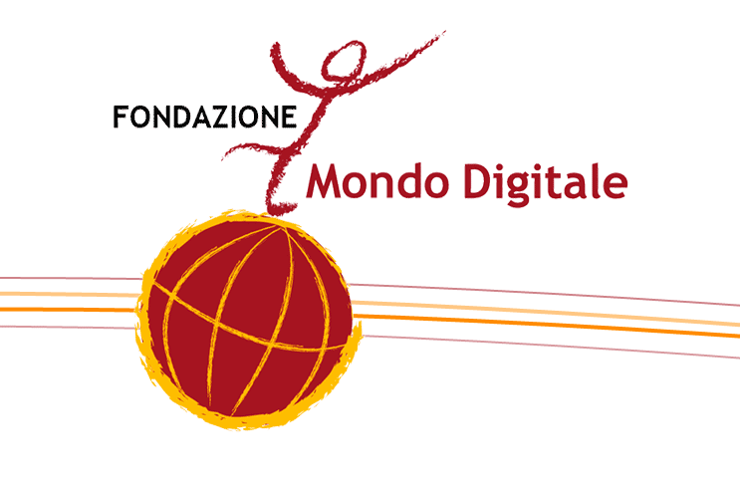

Unleashing Technology to Advance
Social and Economic Development
John Vassallo
Associate General Council, VP EU Affairs, Microsoft Corporation
“Social Innovation for a Better World in Our Time”
Fondazione Mondo Digitale
Rome, 7th October 2009
Notes:
Thanks to FMD for invitation to speak on social innovation and the role we feel at Msft that technology should play in advancing social & economic development.
Technology can be an amazing tool for social and economic development. It can help people get a better education,
learn new skills to earn a living wage, or start a business. It also can enable organizations, NGOs in particular to meet community needs
by broadening access to healthcare, education, micro-banking and other essential services.
The challenges tackled by the non-profit sector are crucial to governments and other decision makers. Because of positive impact technology can have on the work and impact of NGOs, it is therefore key to ensure to continue to invest in innovation and to encourage the progress of digital economy.
I will today point out to you:
1. How new technologies can revolutionize the work and impact of NGOs.
2. What Microsoft does in order to support the non-profit sector in these new challenges.
But before I go more into detail about this idea, let me address our hosts of the day.

Slide 2



Microsoft-FMD Partnership
The Aeneas Centre: immigrant social inclusion
  Facilitating immigrants integration: 400 participants
ICT for Abruzzo
  New and recycled pc collection, system configuration & installation (Microsoft volunteers).
  IT support for Judiciary sytem in area.
  In progress: School PC program to ramp up education activities
Notes:
The Aeneas center:
- location where political refugees live and receive training, primarily Italian language but also information technology.
3 million migrants arrived in Italy in the last decade.
Training for immigrants is difficult. 2009, through a Microsoft Unlimited Potential grant, Fondazione Mondo Digitale implemented a customized digital literacy training program to help refugees and asylum seekers
Hosted by the Municipality of Rome at the Aeneas refugee center, and supported by the Ministry of Social Solidarity and the Job Orientation Center of the Municipality of Rome
400 migrants will receive end-to-end support through language and technology skills training, legal advice, personal training, and health care assistance to better assure their autonomy and employment prospects when starting their new lives in Italy.
FMD-Microsoft partnership at Abruzzo earthquake last year:
60,000 people displaced from their home and living in tents.
FMD has been the recipient of the Microsoft cash donations, that have been used to organize IT activities at needy organizations, such as the judiciary system or for activating PCs at specific locations together with the civil protection service (multimedia tents).
Microsoft volunteers, coordinated by FMD, have contributed to install and configure the machines.
Just like for FMD, technology can be a critical enabler in helping NGOs & community organizations rise to the challenge in the new era of doing business. I would like to use the opportunity to speak to this group about some of the latest findings concerning this challenge.

Slide 3
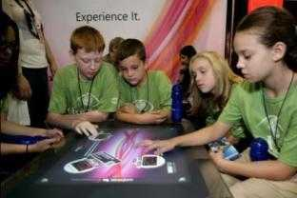


Constructive Disruption
Notes:
Constructive Disruption Can Drive Social Change! (i.e. disruption caused by new business models)
The technology scene today is distinguished by the convergence of device connectivity, software innovation and cloud-based services, which enable people and organizations to access information, communicate and collaborate in more powerful ways. But how can these technologies be used by non-governmental organizations (NGOs) and nonprofits to benefit the most vulnerable people in society?
Microsoft realized that many nonprofits have already embraced technology to improve their productivity and ease their constant struggle to do more with less. But today’s technologies have potential to go much further – the potential for “constructive disruption” that enables nonprofits to achieve dramatically greater impact through new business and service models.

Slide 4
Notes:
Information Technology is evolving at a rapid pace and because of ability to store data in the cloud you are now seeing convergence between 3 devices – TV, Computer and Mobile Phone
This convergence is leading to innovation in products and services and these innovations are leading to disruption, creating new business models, delivery models, information exchange models and networking models.
Software-plus-Services: How does this work? - Rich client software on personal computers and interconnected devices will be complemented by « cloud » applications. Microsoft’s vision is to enable customers to choose the combination that best meets their needs.

Slide 5

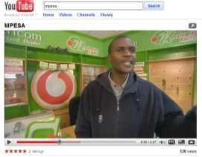
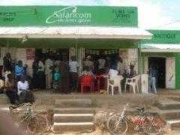


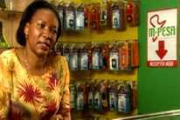

New Business Models
Notes:
Let me give you a couple of examples for NGOs, using new business models - embracing « The Cloud »
Kiva (www.kiva.org), the world's first person-to-person micro-lending website, empowering individuals to lend directly to unique entrepreneurs around the globe founded in 2005, uses the Internet to facilitate small loans from individual lenders to hundreds of thousands of entrepreneurs in 49 countries. Through technology, Kiva is facilitating one-to-one connections that were previously prohibitively expensive and is thereby helping alleviate poverty.
Similarly, other nonprofit “microgiving” intermediaries such as HopeMongers, See Your Impact and the Jolkona Foundation are embodying new efforts to create one-on-one online connections between donor and beneficiary. Through the Web, a donor can provide direct financial support and the beneficiary can share the resulting benefits via video and photographic updates delivered to the donor’s home, office or mobile device. The important innovation here is the ability for small NGOs to quickly and seamlessly upload photographs and videos of their beneficiaries by using inexpensive mobile devices.
M-PESA, a mobile payment solution for people in Kenya who do not have bank accounts by allowing users to deposit cash at a local mobile agent office, send money to other mobile phone users via text and withdraw cash at another local agent. (This innovative private-sector solution is allowing a large number of poor people to save and send money, turning the traditional banking model on its head. In response, governments are scrambling to develop policies that could either promote such efforts or restrict them. Clearly, this is an area of both opportunity and concern for nonprofits that are in the microfinance and micro-banking space.)

Slide 6
Supporting NGO Adoption of
New Models for Social Change
Technology Innovation
Developer Community Support
Social Networking
IT Capacity Building & the Partner Ecosystem
Notes:
You have now seen the potential of new technologies for the non-profit sectore. Based on Microsoft’s experiences working with these organistations around the world for over two decades, we believe that realizing this potential will require attention and investment in 4 key areas.
Technology Innovation – Nonprofits need to continue advancing their technological capabilities, and technology providers need to help ensure that today’s innovations are affordable and accessible to NGOs. Microsoft meets this challenge in part by donating close to US$400 million worth of software each year to help establish stable and secure IT platforms for over 30,000 NGOs and nonprofits globally. We’re also deeply involved in developing specific technologies to meet local community needs. One example is our recently launched OneApp, which enables feature phones, commonly found in emerging markets, to access popular mobile applications.
2. Developer Community Support – The software developer community must be encouraged to continue creating innovative technologies that address societal needs. Among other efforts, Microsoft works to encourage the developers of the future through the Imagine Cup, our annual technology competition, which challenges students to use technology to address the United Nations Millennium Development Goals. We’ve seen incredible innovations entered in this competition. This year more than 300,000 students from over 100 countries participated.
3. Capacity Building and the Partner Ecosystem – Over the past decade, Microsoft has focused on building out NGO partnerships to deliver scalable IT services for the broader nonprofit community. We’re working to increase the IT expertise and capacity of organizations like NPower, TechSoup, Telecentre.org and NetHope, a consortium of 25 leading nonprofits engaged in humanitarian relief and development issues. To help guide nonprofits on the effective use of technology, we’ve held our NGO Connection Days in over 50 locations around the world.
4. Social Networking - The immediacy and influence of online social networking make it a powerful tool for NGOs to use to improve services and operational capacity. Microsoft is working to help NGOs better understand how they can use social media to reach their constituents and beneficiaries. And to facilitate social networking among nonprofits, we launched the NGO Connection web site, an online community where organizations can easily locate technology resources and learn from one another.
Microsoft is investing in this space and is indeed investing in each of these 4 areas.

Slide 7
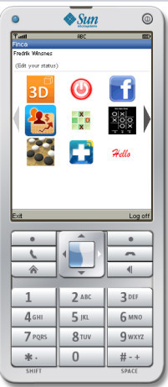
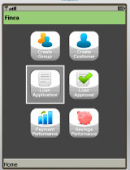
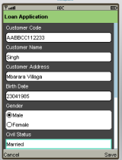
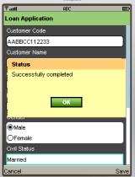

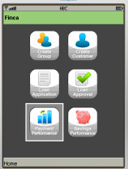

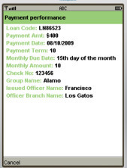
Innovation: OneApp
Data Entry
Data Query
Notes:
One example how Microsofts invests in Technology Innovation for the NGO-Sector
OneApp (www.microsoft.com/oneapp) is online software that expands the capability of “feature phones”—mobile phones commonly found in emerging markets that are capable of running some applications but lack the capabilities of smartphones—to send messages, make financial transactions and find information.
OneApp also serves as a platform for developing new mobile applications. This affords a tremendous opportunity for making richer features and functionality available to mobile phone users around the world, including NGO staff members working in underserved and emerging markets.

Slide 8

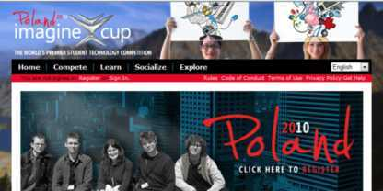

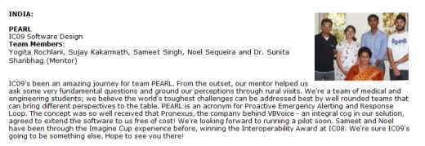

A Developer Community
Notes:
Developer Community Support
Encouraging the developer community to create innovative technologies that address societal needs is a key to strengthening the NGO and nonprofit sector:
With Imagine Cup, Microsoft holds an annual technology development competition for students from around the world. In 2009, the students werer challenged to create software solutions in relation to the United Nations Millennium Development Goals. More than 300,000 students from over 100 countries participated. And the winning entries included solutions designed to improve software accessibility for the blind, increase food production, and improve access to healthcare in remote areas.

Slide 9



IT Capacity
Unleashing technology to advance social and economic development
Transform through Innovative Technology
Economic & social development opportunities
NGO IT challenges; NetHope
Optimize Service Delivery
IT services, support and training
NGO Connection Days; volunteering, partner
expertise, NGO CIO engagement;
Access Stable & Secure Technology
Software, tools, and know-how
Software + Services; NGO Connection
Website; TechSoup
Notes:
Building IT Capacity in the NGO-Sector is Microsoft’s main objective
This happens on three levels:
Access: Software Donations
Microsoft donates US$400 million worth of software each year to help establish stable and secure IT platforms for over 30,000 NGOs worldwide. Example: TechSoup is a non profit that offers NGOs donated & discounted technology products in 35 countries.
Optimize : NGO Connection Days
We are holding regular events that bring togther NGO leaders, industry experts to educate NGOs on technology (40 events each year ww reaching 3,000+ NGOs).
Increase IT expertise through employee volunteering, ecosystem partner support (e.g. developers). Engage NGO IT networks to educate & help NGOs effectively utilize MS technology.
Transform: For high level alliances: SoftWare, Cash, Business support.
Drive transformational change for scaled results through NGO alliances in key sectors e.g. disaster/humanitarian – Nethope: 27 NGOs worldwide that work on disaster relief (including Save the Children, CARE, Oxfam). Msft supports Nethope in enabling best use of technology for connectivity in the developing parts of the world. Aim is for high impact and replicable results.

Slide 10
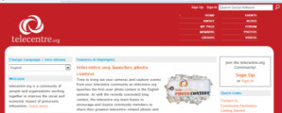
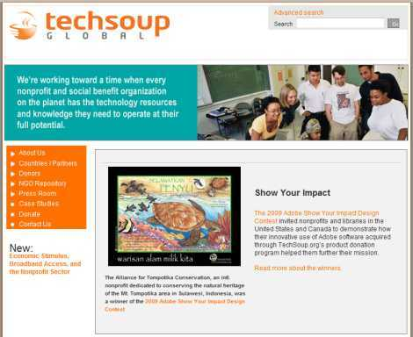
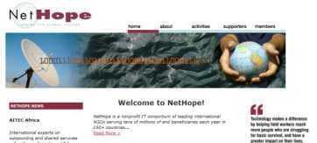
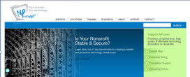
Social Networking: www.microsoft.com/ngo
telecentre.org:
70 countries, 80,000 telecentres
NetHope
Consortium:
150 countries,
26 NGOs
NPower:
11 local chapters,
4,000 NGOs
TechSoup Global: 26 countries, 30,000 NGOs
Notes:
NGO Connection: www.microsoft.com/ngo A website to assist NGOs in accessing
and using technology with NGO community resource:
Available 7 languages
Connect in online forums
Software and hardware support
View stories and videos

Slide 11
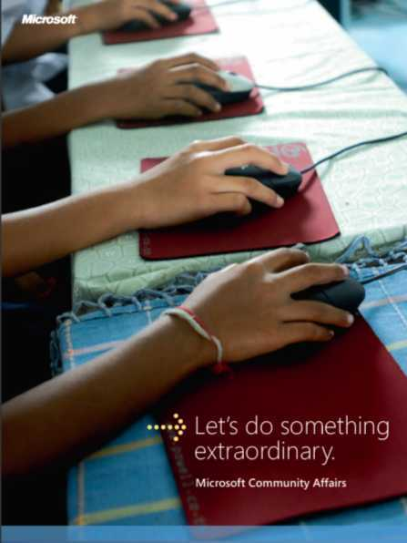
Thank you!
www.microsoft.com/
citizenship
www.microsoft.com/NGO
Notes:
This presentation was based on a White Paper, Microsoft issued last week, called. Unleashing Technology to Advance Social and Economic Development. It explores how technology can be a critical enabler in helping NGOs & community organisations rise to the challenge in the new era of doing business and is based on Microsoft’s experiences working with NGOs and nonprofits around the world for over two decades..
I highly recommend reading it in detail – you will find it in the follow-up booklet of this conference

Slide 12

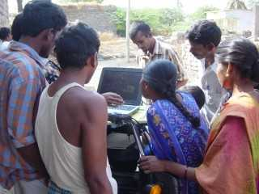
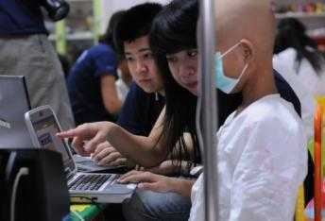
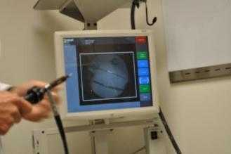


New Delivery Models
Notes:
Two examples for New Delivery Models
1. Many communities, especially in impoverished and remote locations, lack sufficient healthcare services. Over thepast several years, increased use of telecommunications and information technologies in the delivery of clinical care has helped bridge this gap. However, the cost of equipment to undertake these telemedicine efforts is still very high.
Through cloud-based services delivered on intelligent devices, organizations are finding new ways to extend the reach of healthcare and reduce its costs. A team led by the International Institute of Information Technology in Hyderabad, India, is working on a battery-powered diagnostic device, costing less than US$100, which can monitor a patient’s heart rate, blood pressure and oxygen levels. This device can send the information through a cell phone to a physician hundreds of miles away who can then offer expert diagnostic and treatment advice to the local health care provider.

Slide 13
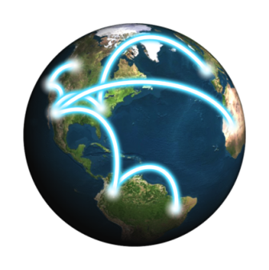

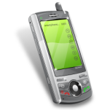
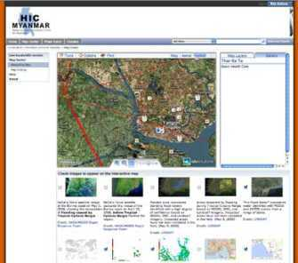
New Information Exchange Models
Notes:
New Information Exchange Models
Effective collaboration is critical in emergency situations that require multiple nonprofits and development agencies to work side by side. This need is driving the creation of new models of collecting and sharing information via the cloud:
Shortly after Cyclone Nargis struck Myanmar in May 2008, the United Nations Office for the Coordination of Humanitarian Affairs (UNOCHA) created a Web-based collaboration portal for aid workers in the region that enabled more than 100 humanitarian relief and development organizations to communicate, analyze information and manage resources. Using e-mail, texting and basic Web connectivity on a mobile phone or other mobile device, aid workers in remote or heavily damaged areas were able to view content, create alerts, file reports, participate in discussion forums and update other information on the portal.
This is a powerful example of the cloud’s capacity to help NGOs narrow the gap between the IT infrastructure at their headquarters offices in the developed world and the more remote locations where their employees, and the people they serve, are often working with limited Internet bandwidth or PC access.

Slide 14

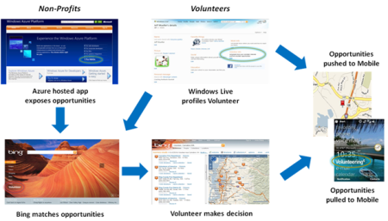










New Networking Models
Notes:
New Networking Models
Social networks such as Twitter, Facebook and YouTube keep many of us connected to a continuous stream of information. NGOs and others in the development community are also seeking to effectively use these powerful tools for social change. An interesting example that may of your know, is “Causes”, a Facebook application that allows people and organizations to mobilize support for a social or political cause through the network.
Microsoft is working to help NGOs better understand how they can use social media to reach their constituents and beneficiaries. To facilitate social networking among nonprofits, we launched the NGO Connection web site, an online community where organizations can easily locate technology resources and learn from one another.

Slide 15
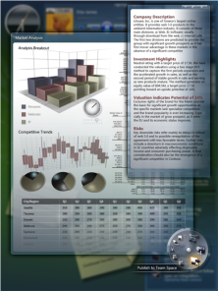



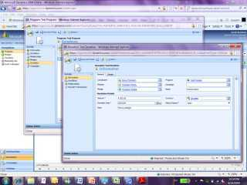


Innovation: Relevant, Appropriate and Accessible Technologies
Notes:
We also recognize that NGOs and nonprofits might need specialized tools or customization in order to reap the benefits of innovation. Our product development efforts include a focus on creating relevance and value for this community. We are working to support innovative
applications of existing Microsoft technologies to help make them more relevant, affordable and accessible to the NGO sector.
e.g. Working with NetHope partners such as Save the Children, CARE, Oxfam International, the Nature Conservancy, World Vision and Ashoka, we continue to explore innovative uses of our technologies such as Microsoft Office SharePoint Server

Slide 16

Community Technology
Skills Program
A global IT skills program
with local implementation
Regional Themes
  Asia – Women’s Empowerment
  MEA – Youth and Women’s Empowerment
  Europe – Employability
  LatAm – Accessibility for the Disabled
  North America – Workforce Development
1000 NGO partners | 102 countries | 86 million people reached

Slide 17


Currently reaching 86 million people in 102 countries
Aspiring to reach 250 million people by the year 2015
Global Investment Overview

